Slide 1
Daily 5
What is an obtuse-angled triangle?
What is an acute-angled triangle?
Define a scalene triangle
Define an isosceles triangle
List the symbols you would use when writing a mathematical proof in place of writing out the following: triangle, congruent, similar and angle

Slide 2
Proofs and Quadrilaterals
EQ – How do I prove properties of quadrilaterals?

Slide 3
Learning Objectives
Properties of quadrilaterials
Increase mathematical vocabulary
How to write a proof

Slide 4
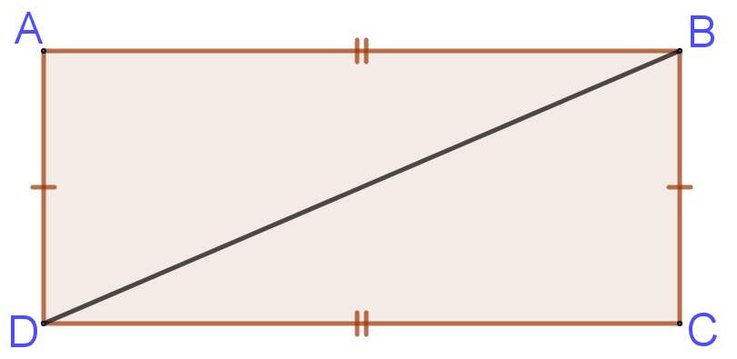
Proofs and Quadrilaterals EQ – How do I prove properties of quadrilaterals?
Task:
What is the difference between congruent and similar?
Prove that the two triangles in the rectangle below are congruent

Slide 5
Proofs and Quadrilaterals EQ – How do I prove properties of quadrilaterals?
Task: In Groups
What are the properties of the quadrilaterals?
Rectangle | Square | Rhombus
Kite | Trapezium | Parallelogram

Slide 6
Proofs and Quadrilaterals EQ – How do I prove properties of quadrilaterals?
Task: In Groups
What are the properties of the quadrilaterals?
Hint –
Sides, angles, diagonals
Rectangle | Square | Rhombus
Kite | Trapezium | Parallelogram

Slide 7
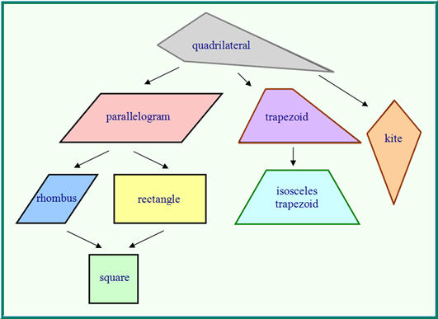

Slide 8
Proofs and Quadrilaterals EQ – How do I prove properties of quadrilaterals?
Note the order the angles in the two triangles are listed. They correspond
Same with listing angles.

Slide 9
Proofs and Quadrilaterals EQ – How do I prove properties of quadrilaterals?

